Slide 1

New VQEG Tools and Subjective Labs Setup Website
Werner Robitza TU Ilmenau, Germany
Glenn van Wallendael
Ghent University, Belgium
VQEG Meeting, Nov. 12–16, 2018 – Mountain View, CA

Slide 2
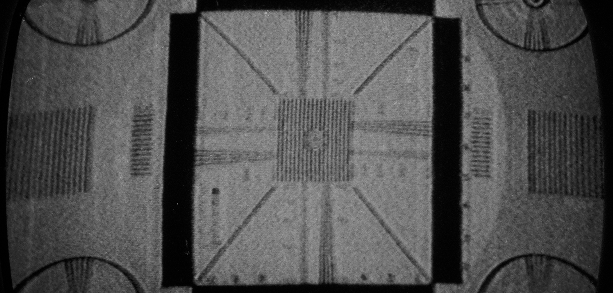
Motivation
Provide a website and repository for:
Software tools for conducting subjective tests and video quality research
Guidelines for research
Video quality databases
Requirements:
Easy to maintain
Everyone should be able to contribute
Simple and reliable hosting, HTTPS

Slide 3
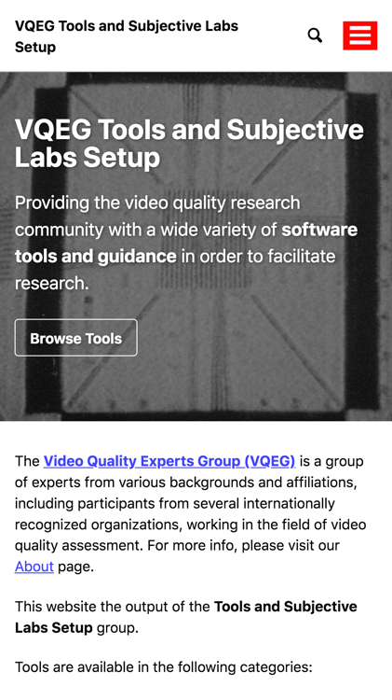
New Website
https://vqeg.github.io/software-tools/
Collection of software tools in different categories:
Quality Analysis (Models)
Stream Analyzers
Encoders
Simulators
Subjective Test Software
List of video database indexes
A page for guidelines on video quality research

Slide 4
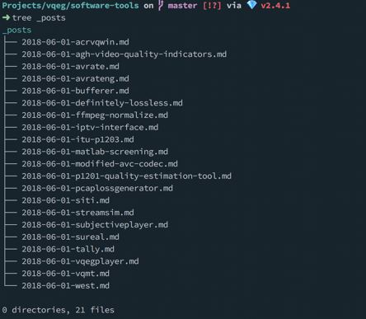
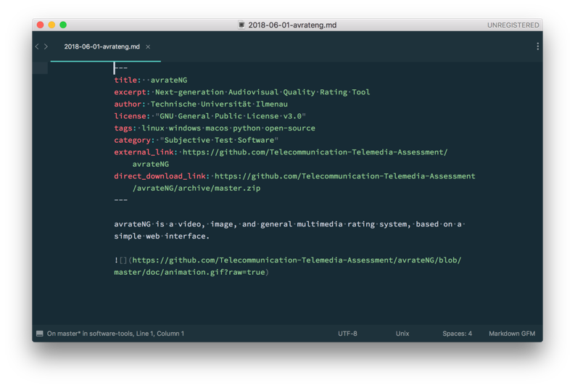
Technology
Backend: Jekyll – a text-based blogging system
Text-based workflow:
The whole website is a Git repository
Website itself is a collection of files
Each tool is just a text file

Slide 5
Hosting
GitHub Pages: Push update to Git repo → GitHub renders site automatically
Benefits
Free and reliable
HTTPS-enabled
Nobody has to „maintain“ it
Easy to migrate to somewhere else
Drawbacks
Not a solution for large file hosting

Slide 6
How to Contribute
The old way: send an email to the maintainers:
glenn.vanwallendael@ugent.be
werner.robitza@gmail.com
The new way: create an issue on GitHub and suggest a tool / change: https://github.com/vqeg/software-tools/issues/
The techy way:
Fork the repository on GitHub
Make changes and commit them
Submit a Pull Request

Slide 7
Discussion
Similar project: QUALINET Databases — http://dbq.multimediatech.cz/
Currently hosted by Czech Technical University in Prague
Possible migration to similar system
To “save” it for the future
To reduce burden of maintenance
Could be a joint initiative of VQEG and QUALINET
Already talked with Karel Fliegel about possibility

Slide 8

Call for Contributions
Please contribute!
https://vqeg.github.io
Your software tools, scripts, …
Guidelines for (subjective) video quality research

